Slide 1
Instacart Data Analysis
~ Sanchari Chowdhuri

Slide 2
Contents
Data set Overview
Analysis Flow
Exploratory Data Analysis
Feature Engineering
Model Creation and Performance Metrics
Conclusion

Slide 3
1. Dataset Overview
The dataset contains order details for 206,209 Instacart Users.
The dataset has 3,421,083 orders.
The dataset has 49,688 product details.
All these products are spread across134 different aisles and belong to 21 different departments.
For these 206209 Users, their previous order details are available as “prior”. Their latest order is segregated into training and testing order.

Slide 4
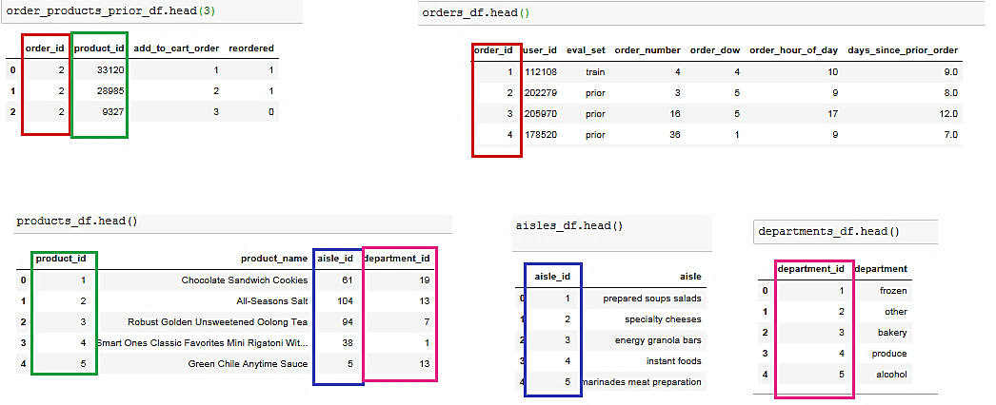
Relationship among different files of the dataset

Slide 5
2.Analysis Flow
Exploratory Data Analysis (Refer 1.Instacart-EDA.ipynb)
Feature Engineering for training Data (Refer 2.Instacart-feature_engineering and flat file creation.ipynb)
Training Model and Testing (Refer 3.Instacart-Logistic Regression and Testing)
Creating Features for test data(Refer testdata_flatfile.ipynb)

Slide 6
3. Exploratory Data Analysis

Slide 7
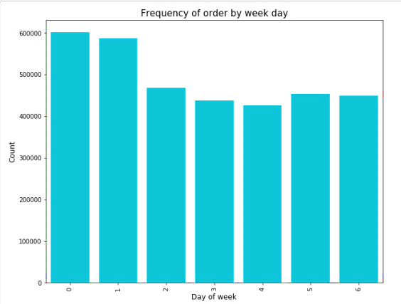
Number of Orders per day of week
Sunday and Monday seems to have higher volume of orders than other days of the week
Towards mid week there is a dip in order volume suggesting people prefer to get their groceries towards weekend or beginning of the week

Slide 8
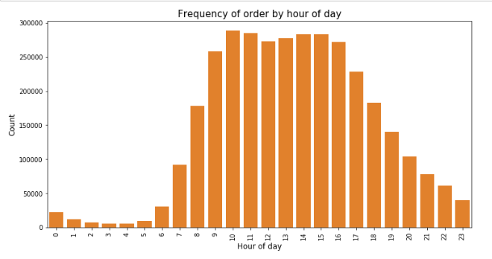
Orders by hours of the Day
People order groceries in day time

Slide 9
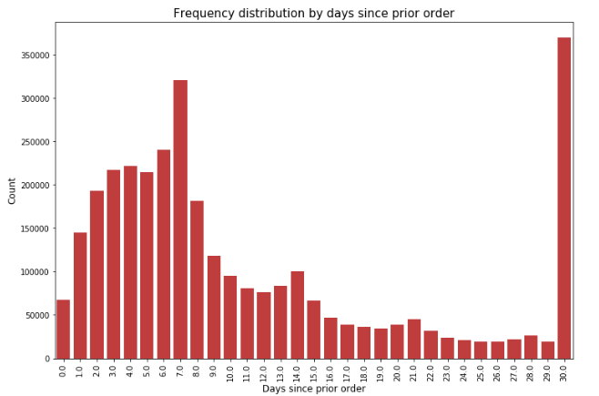
How frequently do customers order?
Customers order Weekly and monthly the most

Slide 10
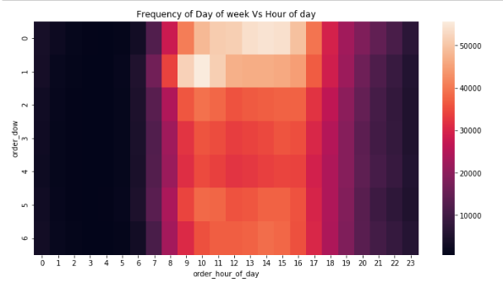
When do customers order the most
Heatmap showing volume of orders across hour of day and day of week

Slide 11
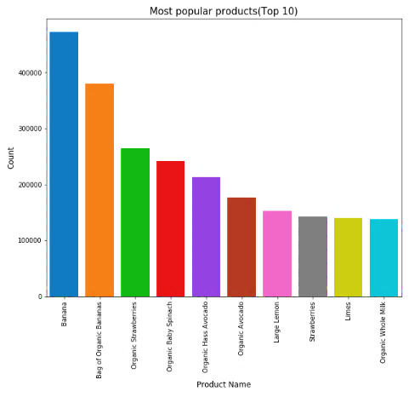
Most Popular products

Slide 12
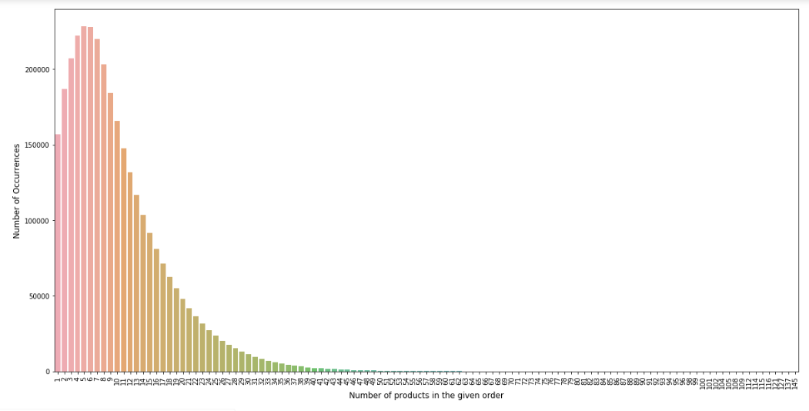
Number of Products in an Order
Right tailed distribution with Peak value at 5

Slide 13
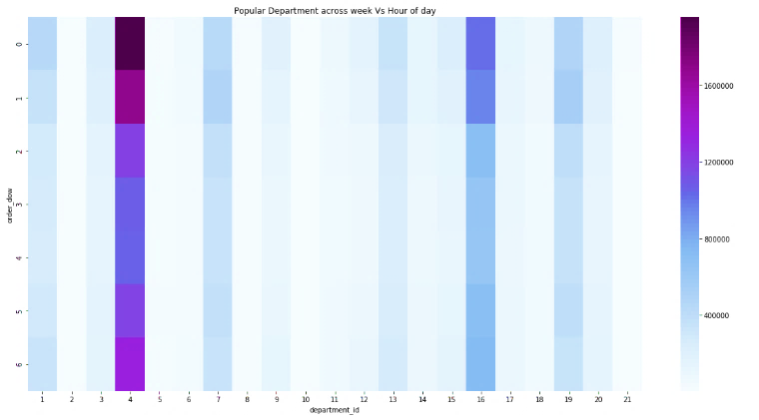
Popular Department across day of week and hours
Department id 4 and 16 are popular throughout the week

Slide 14
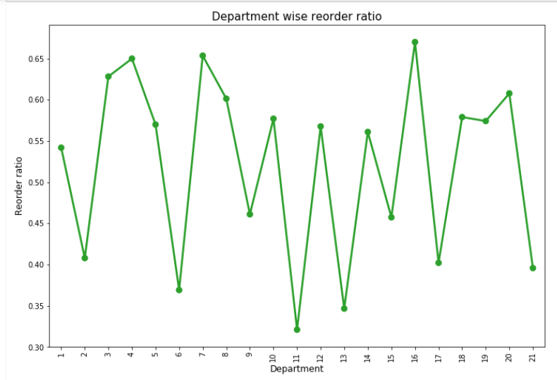
Departmentwise reorder ratio
Department id 4 and 16 have high reorder ratio

Slide 15
Feature Engineering
23 new features are created for User- product pair
Feature Name | Description
user_product_avg_add_to_cart_order | this column tells the average add to cart order of the product for this user
user_product_total_orders | how many times this product was ordered by this user
user_product_avg_days_since_prior_order | average number of days elapsed since last time this product was ordered by the user
user_product_avg_order_dow | average day of the week when the user orders this product
user_product_avg_order_hour_of_day | average hour of the day when the user orders this product.
In_cart | This tells whether a prior product ordered by the user is also present in the current order
product_total_orders | How many times a given product has been ordered overall
product_avg_add_to_cart_order | This tells the average add to cart order of the product
product_avg_order_dow | This tells the average day of week when this product is ordered
product_avg_order_hour_of_day: | the average hour of the day when this product is ordered the most
product_avg_days_since_prior_order | average number of days elapsed since this product was last ordered

Slide 16
Feature Engineering (….contd)
Feature Name | Description
user_total_orders | Total number of orders placed by the user
user_avg_cartsize | Average cart size of the user
user_total_products | Total number of products ordered by the user
user_avg_days_since_prior_order | Number of days elapsed between subsequent orders
user_avg_order_dow | Average day of the week when user places order
user_avg_order_hour_of_day | Average hour of the day when user places order
user_product_order_freq | Ratio of user_product_total_orders and user_total_orders
product_total_orders_delta_per_user | difference between total number of orders placed for the product and total number of orders placed for the product by the specific user.
product_avg_add_to_cart_order_delta_per_user | difference between product's average add to cart order based on all users and product's average add to cart order based on this specific users.
product_avg_order_dow_per_user | difference between average day of week when the product is ordered based on all users and average day of week when the product is ordered based on this specific user
product_avg_order_hour_of_day_per_user | difference between product's average hour of day when ordered and product's average hour of day when ordered by this user
product_avg_days_since_prior_order_per_user | difference between product's average days elapsed since last order placed and average days elapsed since last order placed by specific user

Slide 17
Training Model
Model Used :Logistic Regression
Independent variable = in_cart [0,1]
Dependent variable are all the previous mentioned features.

Slide 18
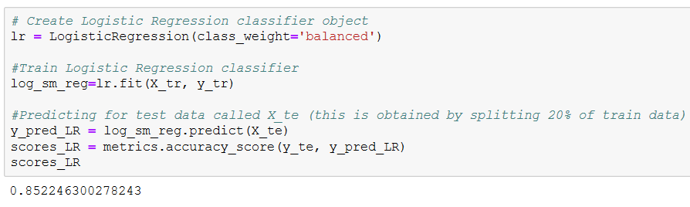
Performance Metrics
Overall Model Accuracy : 85.2%
Although the Overall Accuracy is high but due to class imbalances accuracy is not the best metrics to quantify the classifier’s performance.

Slide 19
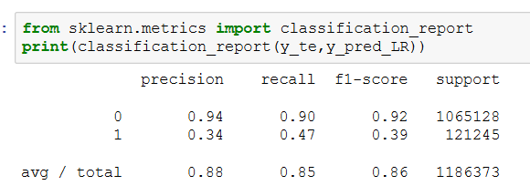
Precision, Recall and F1 Score
F1- Score Class 1 =0.39
Precision Class1=34%
Recall Class1 = 47%

Slide 20
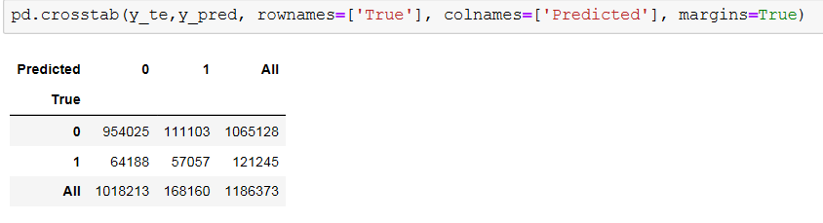
Confusion Matrix
Out of 1065128 instances of a product not being ordered -
954025 times the classifier was correctly able to predict that the product would not be reordered
111103 times the classifier misclassified a not ordered product as reordered product.
Out of 121245 instances of a product being reordered -
64188 times the classifier misclassified a reordered product as not currently ordered.
57057 times the classifier correctly classified product as reordered

Slide 21
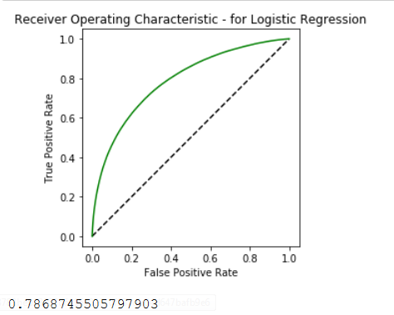
ROC Curve
Area Under Curve is 0.78

Slide 22
Test Data (order_products__test_cap.csv)
The test data contains 32804 unique order ids which belongs to 32804 users.
These are testing users.
This test data have to be normalized (by merging prior order-product history of 32804 users)
After all the product, user and product-user based features are obtained for these 32804 test users, the classifier trained previously will be used to predict the products ordered by these 32804 test users.

Slide 23
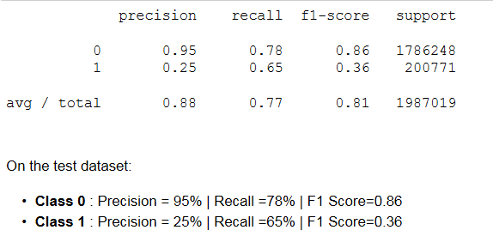
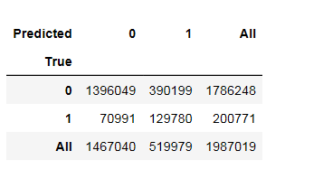
Model Metrics on Test Data.
Model Accuracy : 76.7%
Precision ,Recall, F1 Score
Confusion Matrix:

Slide 24

Next Steps….
The training data has class imbalance. There are more instances for class 0(“ product not being in latest order”) than class 1 (“product being in latest order”)
Currently class_weight='balanced‘ is used in training the logistic Regression. Which effectively tells that each class is equally important.
However, Oversampling and under sampling will create equal number of instances for both the classes
Conduct SMOTE (Synthetic Minority Over-sampling Technique)
By creating synthetic (not duplicate) samples of the minority class. Thus making the minority class equal to the majority class.
Conduct NearMiss
This is an under-sampling technique. Instead of resampling the Minority class, this will make the majority class equal to minority class.

Slide 25
Thank you

